Slide 1
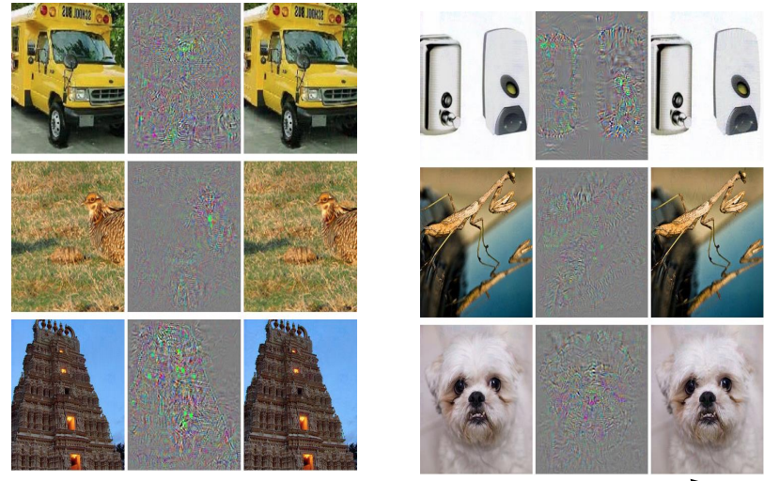
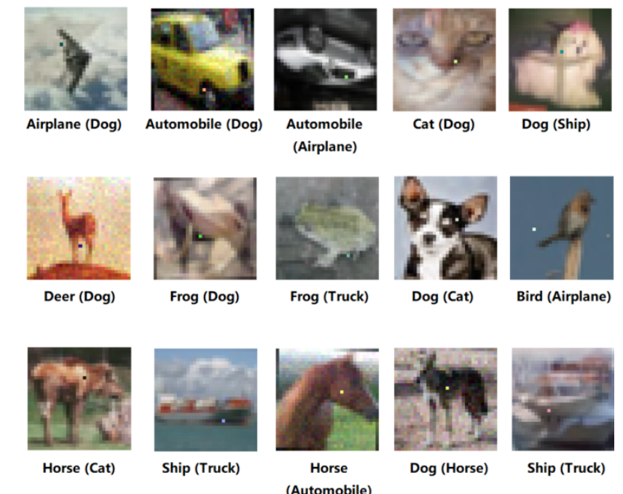
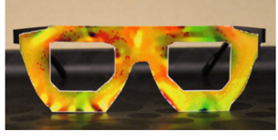
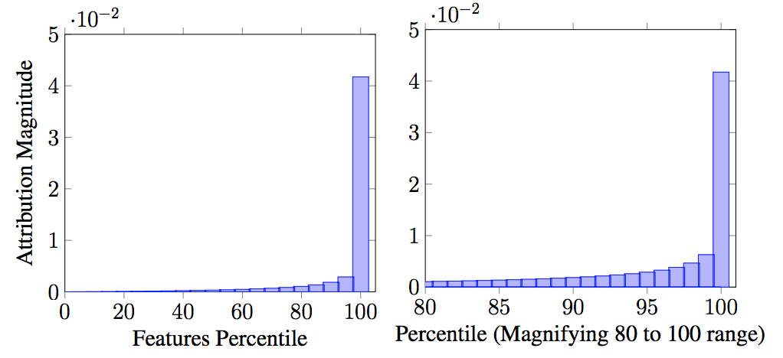
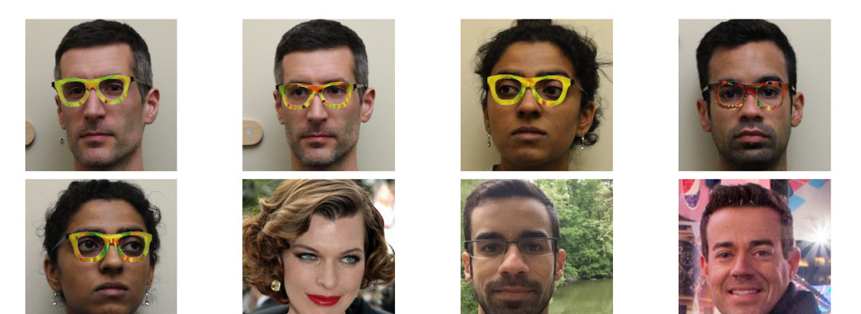
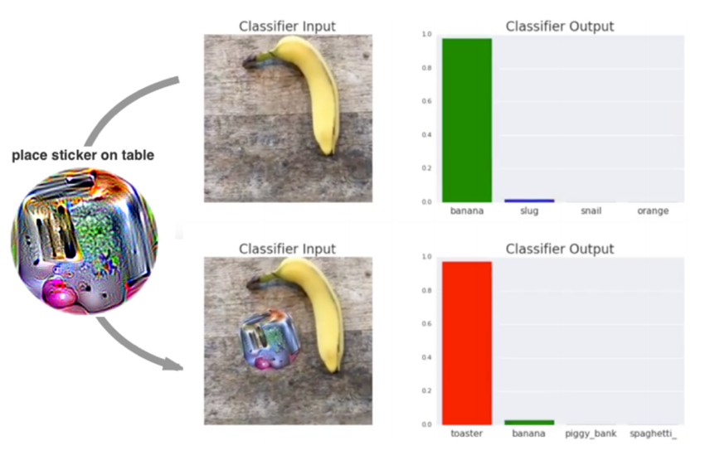
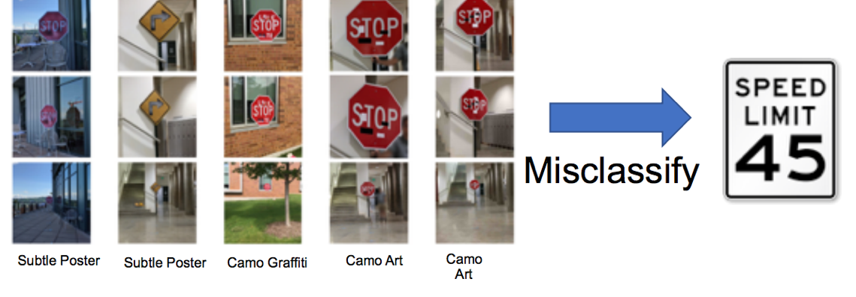
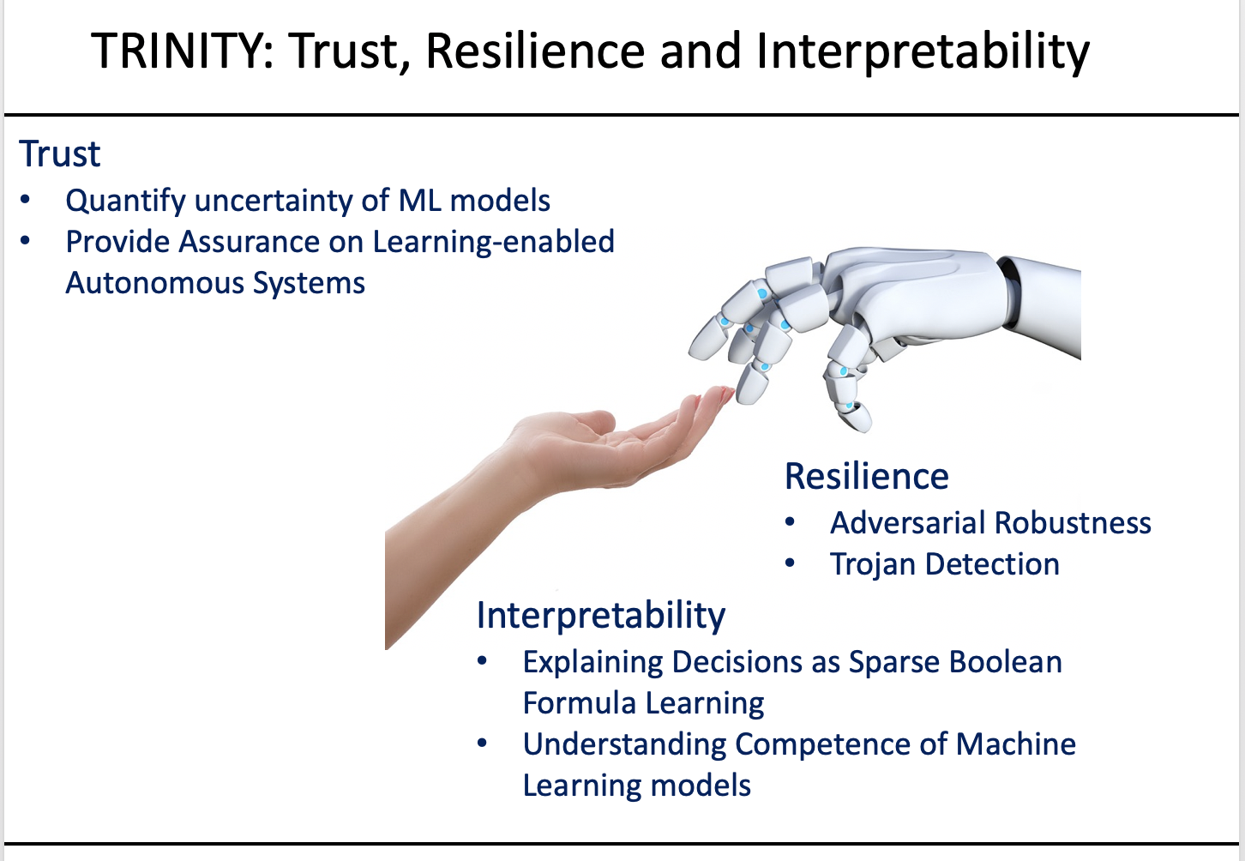
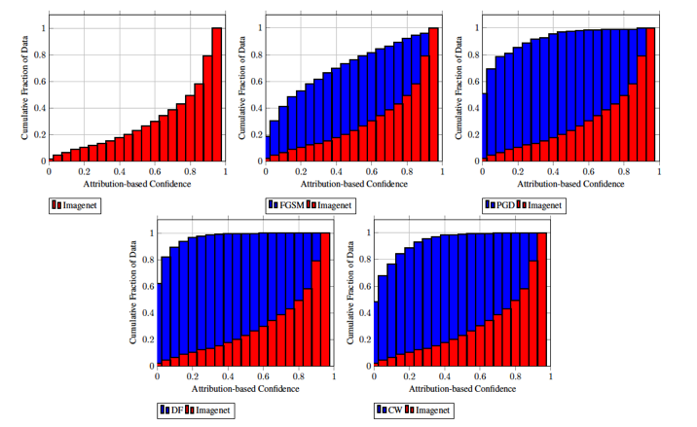
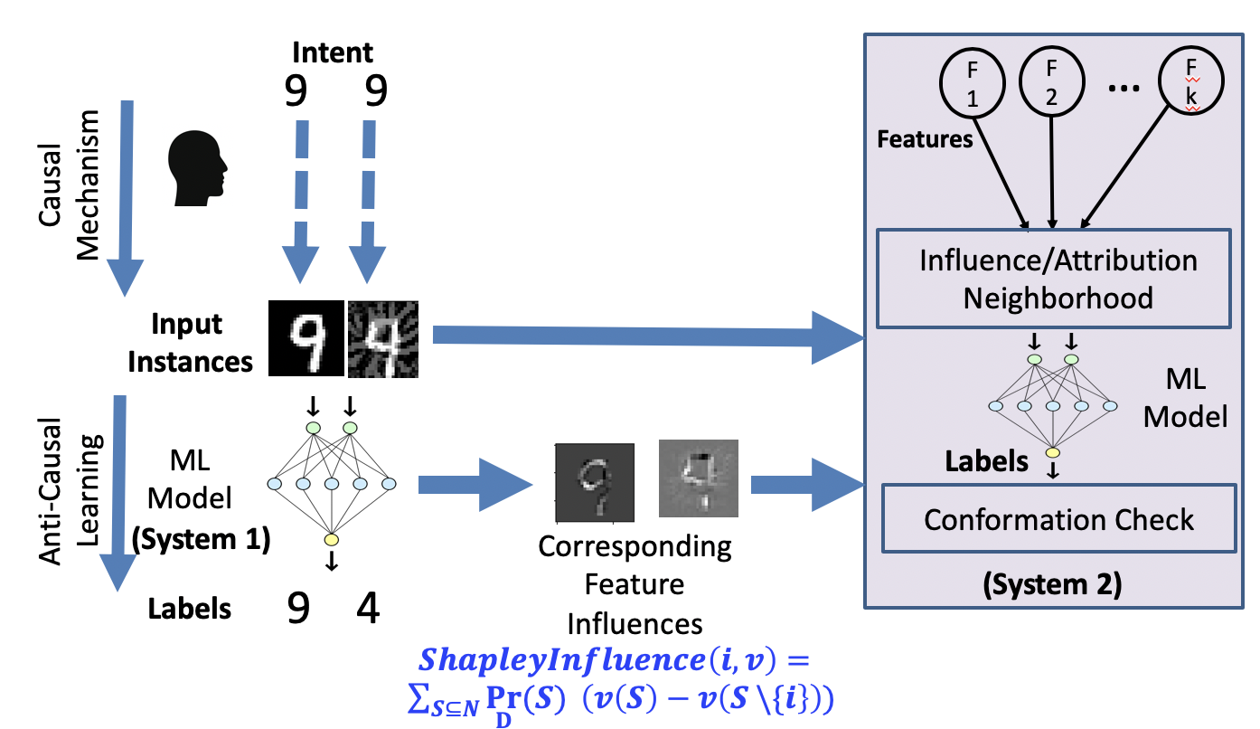
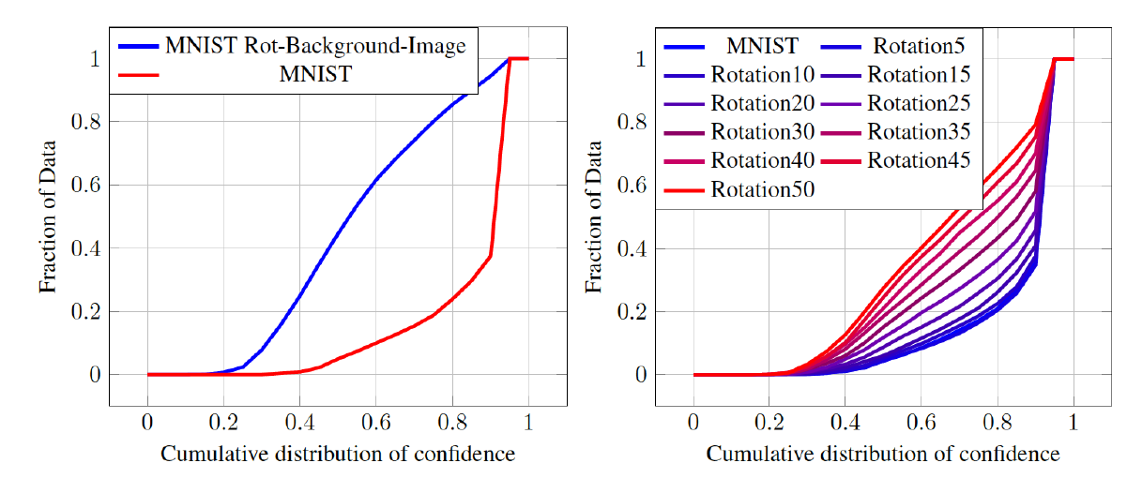
Activity Detection with Unconventional Modalities
Relevant to IOBT CRA Research Area / Task: Research Area 2, Task 2.3
Objective
Detecting Adversarial Attacks on Machine Learning Models
Results
Conclusions
We employ an attribution-driven sampling of the neighborhood of a given input and measure the conformance of the model’s predictions to compute the attribution-based confidence (ABC) metric for DNN prediction on this input.
While directly sampling the neighborhood of a high-dimensional input is challenging, our approach uses attribution-based dimensionality reduction for finding locally relevant features in the vicinity of the input, which enables effective sampling.
We theoretically motivate the proposed ABC metric from the axioms of Shapley values, and experimentally evaluate its utility over out-of-distribution data and adversarial examples.
Our approach is particularly suitable for detecting adversarial patch attacks which are physically realizable.
Smaller the patch, the better our approach will perform in detecting the adversarial attack!
Szegedy et al, 2013, 2014
Sharif et al, 2016
Evtimov et al., 2017
Brown et al. 2017
Approach
Compute attribution of features
Construct causal neighborhood using attribution for importance sampling
Measure conformance of ML model in this neighborhood.
Path Forward
Replace conformance with more fine-grained measures such as distribution shift metrics.
Temporal evolution of attributions to detect adversarial attack at instance of occurrence.
Jha et. al. Attribution-Based Confidence Metric For Deep Neural Networks, NeurIPS’19
Jang et. al. On the Need for Topology-Aware Generative Models for Manifold-Based Defenses, ICLR’20
Jha et. al. Detecting Adversarial Examples Using Data Manifolds, MILCOM’18
Kiourti et. al. TrojDRL: Trojan Attacks on Deep Reinforcement Learning Agents, DAC’ 20
POINT OF CONTACT:
Susmit Jha
susmit.jha@sri.com
Brian Jalaian
brian.a.jalaian.civ@mail.mil
UNCLASSIFIED // FOUO
Notes:
a et. al. Attribution-Based Confidence Metric For Deep Neural Networks, NeurIPS’19
Jang et. al. On the Need for Topology-Aware Generative Models for Manifold-Based Defenses, ICLR’20
Jha et. al. Detecting Adversarial Examples Using Data Manifolds, MILCOM’18
Kiourti et. al. TrojDRL: Trojan Attacks on Deep Reinforcement Learning Agents, DAC’ 20

